Slide 1
Bald Eagle Permits
April 15, 2020
ENVE 644
Environmental Management and Permitting
Notes:
I don’t have cool movie references like Sophie had on her first presentation
My presentation is full of boring slides
We heard from Bob Henszey with F&WS two weeks ago, and he touched on eagle permits

Slide 2
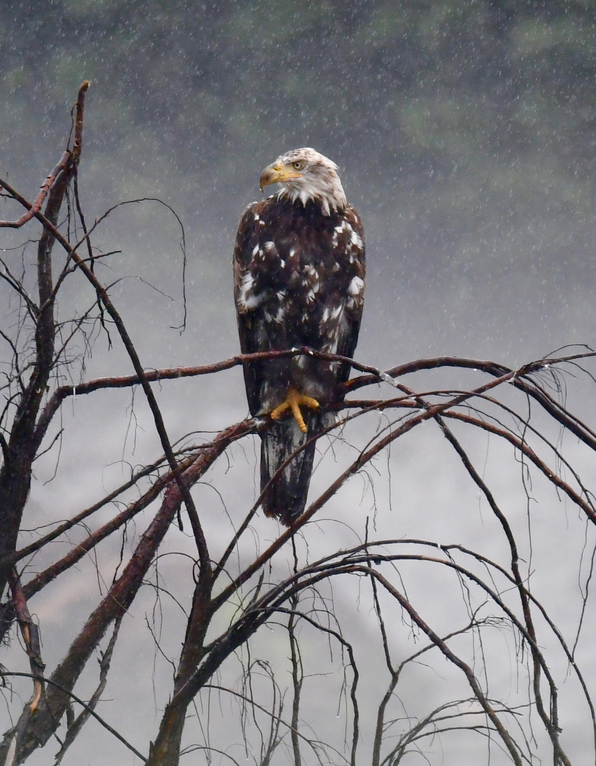
Outline
Background
Jurisdiction
Permits
Application Process
References
Q&A
Notes:
Significance of eagles, history of protection
Who has jurisdiction over eagles, what are the specific protections, what are the penalties
A description of permit triggers and the types of permits issued
Specifics about the application process
References and Q&A

Slide 3
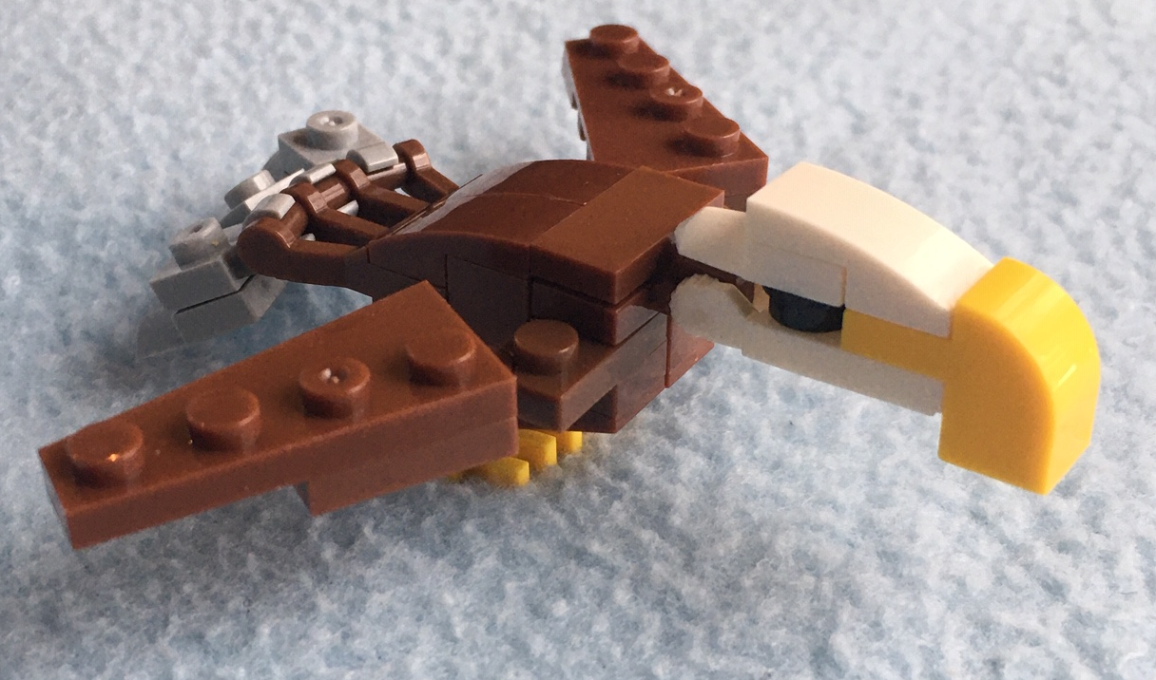
Background
Notes:
My daughters got nature themed easter eggs with “Lego” animals
Seemed appropriate, given the timing of this presentation

Slide 4

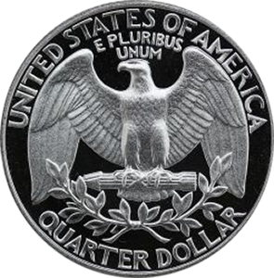

Symbology
https://www.philadelphiaeagles.com/
http://washington-quarters.com/coins/300x300/1998-quarter-reverse.png
https://cdn.wallpapersafari.com/9/95/uFhy9V.jpg
Notes:
Bald Eagles are a symbol of national pride, patriotism, and freedom
It can be found throughout US culture, from official depictions on currency to sport such as the Philadephia Eagles
Spiritual symbol of Native Americans and Native Alaskans
The Eagle is considered to be a messenger to the Creator.

Slide 5

History
A national symbol
1782
The Continental Congress adopted the bald eagle as the national bird.
Bald eagles appear on most official seals of the United States.
1940
Congress enacted the Bald Eagle Protection Act.
Great Seal of the USA
https://upload.wikimedia.org/wikipedia/commons/5/5c/Great_Seal_of_the_United_States_%28obverse%29.svg
1962
Amended to become the Bald and Golden Eagle Protection Act
Notes:
The founders of the United States were fond of comparing their new republic with the Roman Republic, in which eagle imagery was prominent.
Approximately 100,000 nesting eagles in 1782
DDT, a popular insecticide, used from in the 1940’s until it was banned in 1972, was a major contributor to bald eagle decline due to eggshell thinning.
The Act provides criminal penalties for persons who "take, possess, sell, purchase, barter, offer to sell, purchase or barter, transport, export or import, at any time or any manner, any bald eagle ... [or any golden eagle], alive or dead, or any part, nest, or egg thereof
In 1917, the Alaska Territorial Legislature, in response to claims by the salmon industry and coastal fox farmers imposed a bounty on eagles. Though the claims were later largely discredited, the bounty system lasted for 36 years and led to the killing of a confirmed 120,195 eagles. The bounty was removed in 1953 and with Alaska statehood in 1959, bald eagles in Alaska came under the federal Bald Eagle Protection Act of 1940.

Slide 6
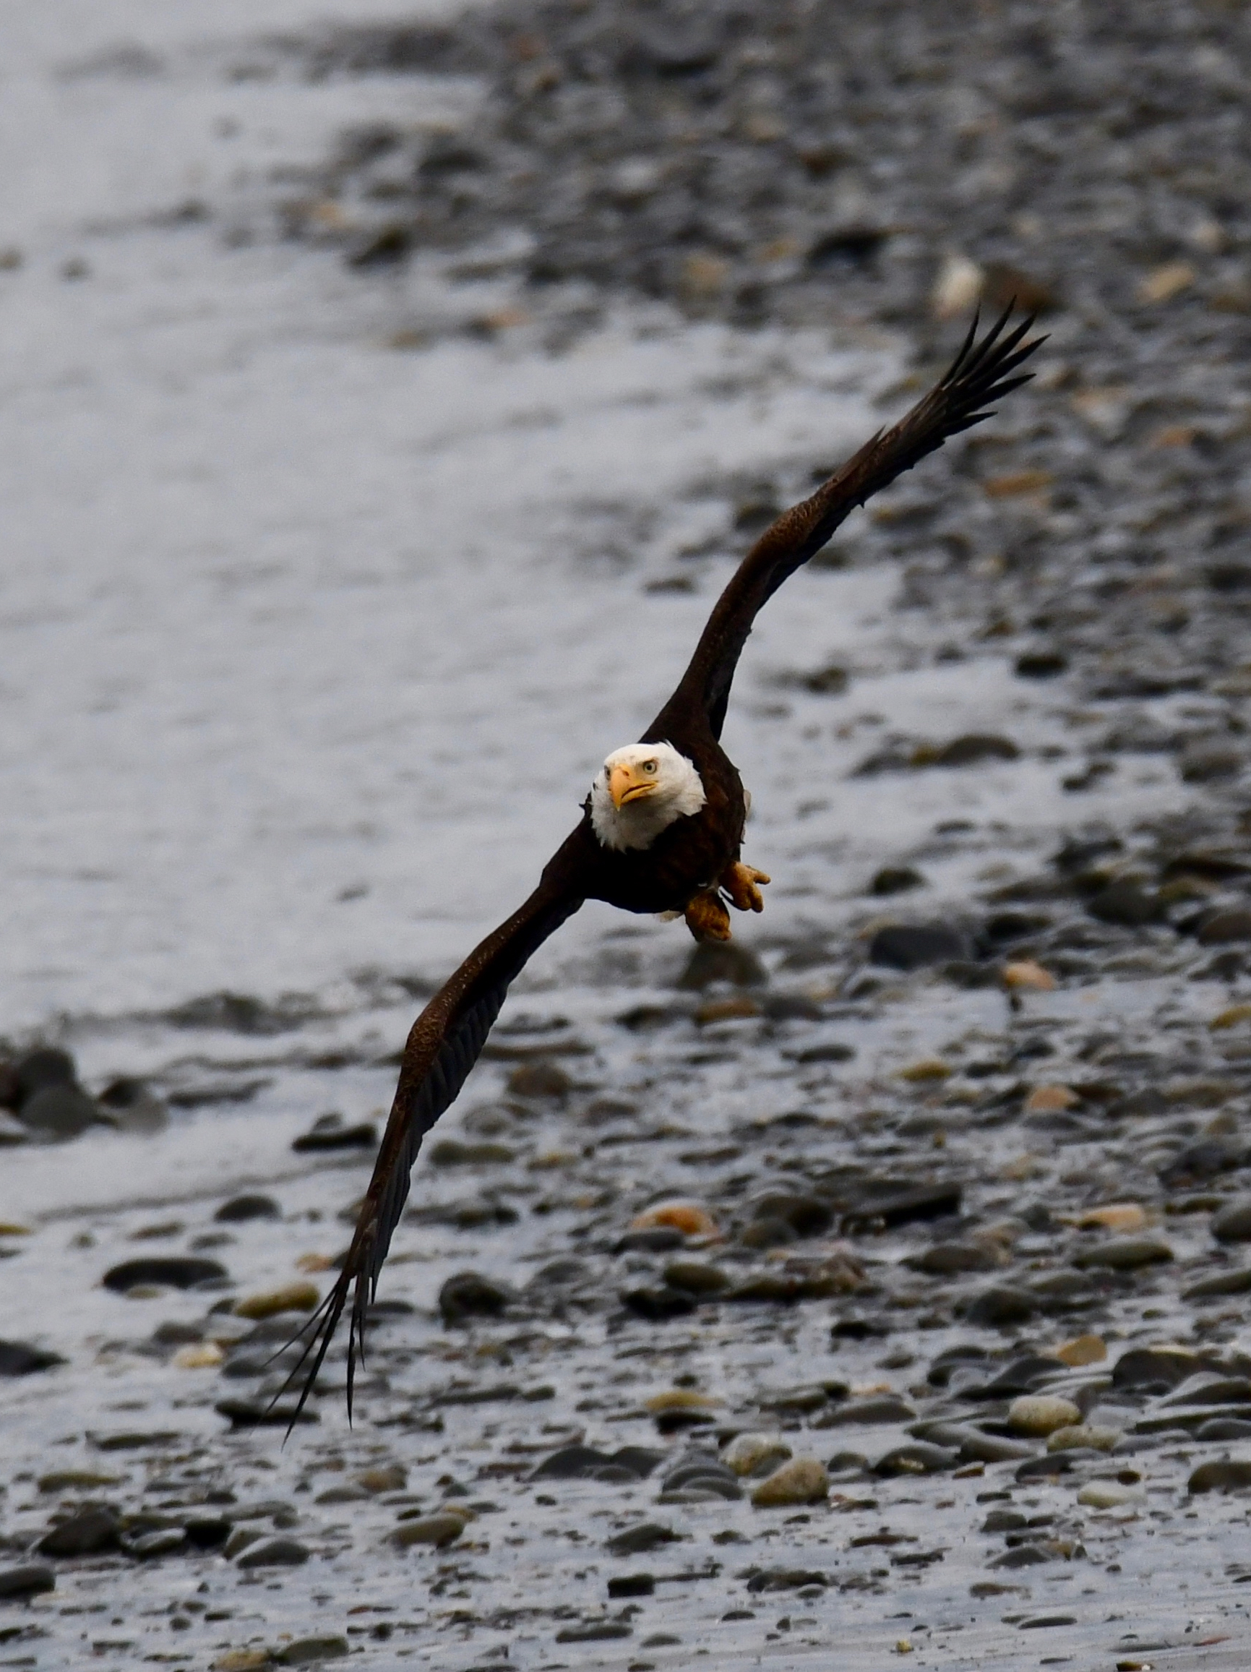
History
A national symbol
1963
Near extinction
1967
Listed under the Endangered Species Preservation Act
1978
Listed as Endangered under the Endangered Species Act
2007
De-listed
Notes:
1963 only 417 nesting pairs remained, caused by DDT poisoning, loss of habitat, and illegal shooting
Endangered only throughout lower 48. HI does not have eagles and populations in Alaska remained robust
In 1995 upgraded threatened, and 1999 started the process of delisting the species from the ESA
Approximately 9,800 nesting pairs in the lower 48 when it was delisted
About 30,000 birds in AK

Slide 7
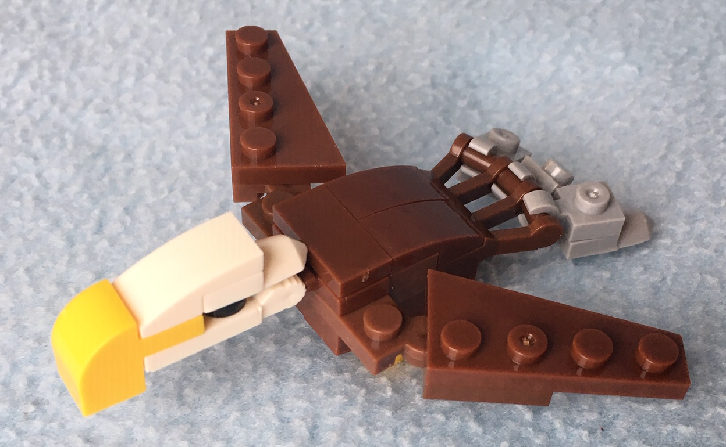
Jurisdiction
Notes:
Which agency has jurisdiction over Bald Eagles and what laws are enforced.

Slide 8
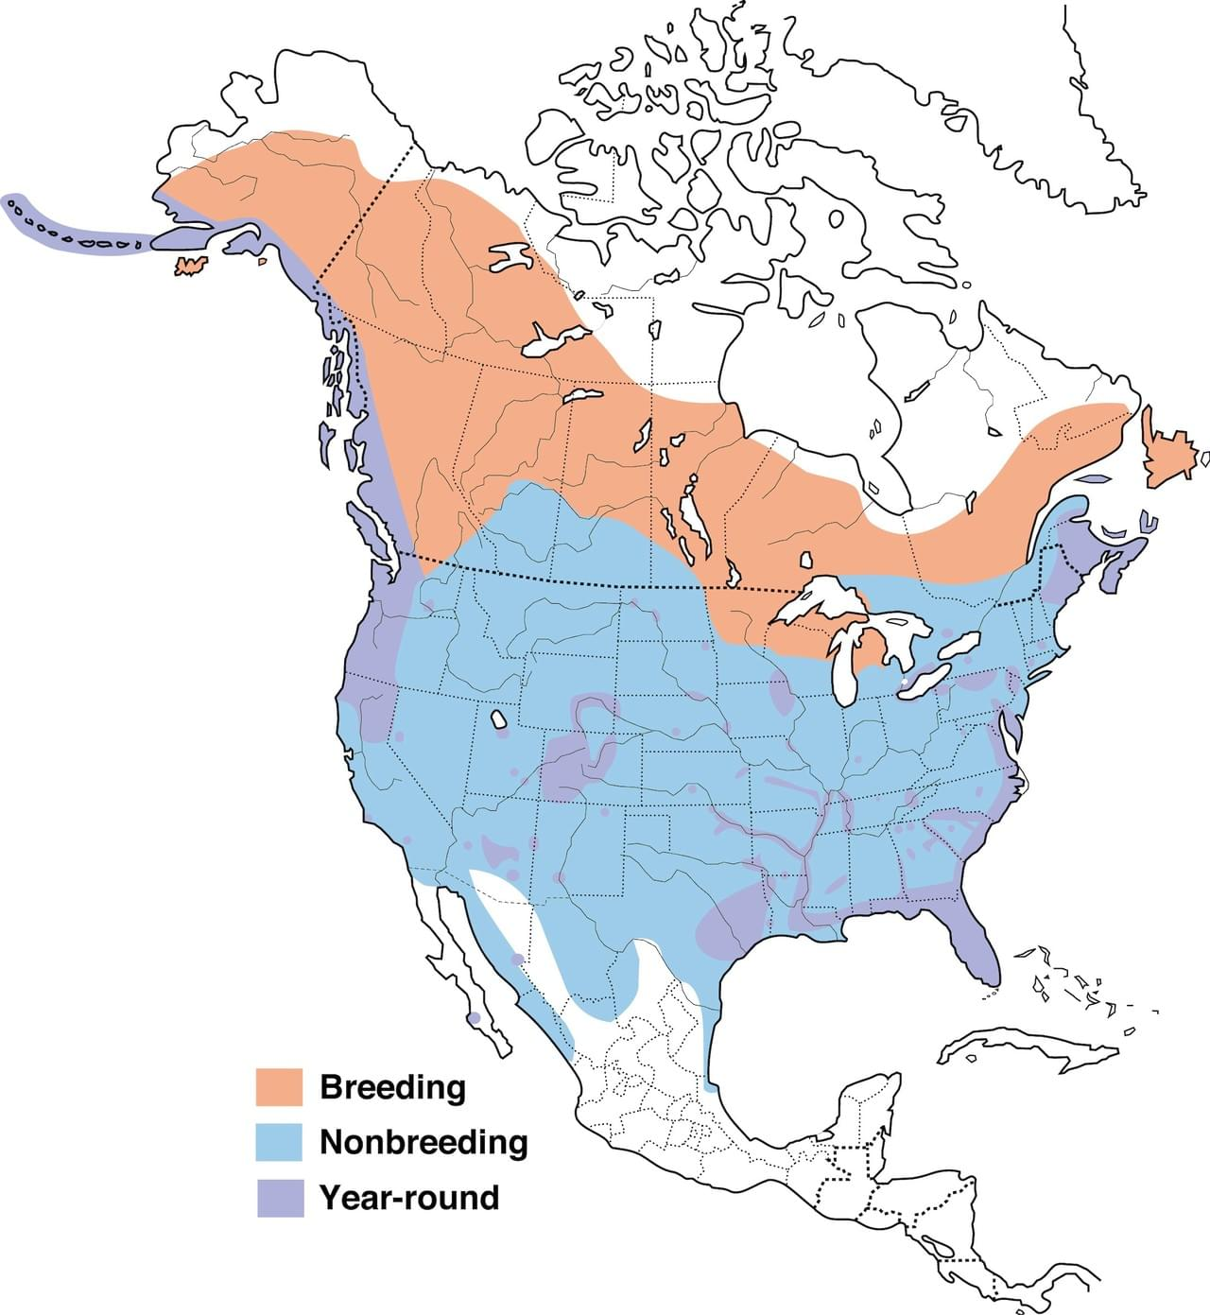

Bald Eagle Range
https://www.allaboutbirds.org/guide/Bald_Eagle/maps-range
Notes:
Resident to long-distance migrant. Complex migration patterns depend on age, breeding location, and food availability. Northern adults begin fall migration when lakes and rivers freeze, usually migrating coastward or to open water. They return to breeding grounds when weather and food permit, usually January–March.
The FWS has primary jurisdiction over eagles throughout the United States. However, Alaska also retains management and permitting authority, and eagle take as defined in the BAGEPA requires written authorization from both the FWS and the Alaska Department of Fish and Game (ADF&G).
For DOT&PF projects, ADF&G defers to a FWS permit.

Slide 9

Bald Eagle Protections
Lacey Act
  16 U.S.C. §§ 3371–3378
  50 CFR 16
Migratory Bird Treaty Act
  16 U.S.C. 703-712
  50 CFR 21
Bald and Golden Eagle Protection Act
  16 U.S.C. 668-668d
  50 CFR 22
Local
  AS 41.21.610-630
Notes:
USC: laws passed by congress, CFR: the interpretation of the USC by the relevant agencies
Three federal laws apply:
Lacey Act (1900): prohibits trade in wildlife, fish, and plants that have been illegally taken, possessed, transported, or sold
Migratory Bird Treaty Act (1918): the statute makes it unlawful without a waiver to pursue, hunt, take, capture, kill, or sell birds listed therein as migratory birds. The statute does not discriminate between live or dead birds and also grants full protection to any bird parts including feathers, eggs, and nests.
Bald and Golden Eagle Protection Act (1940 amended 1962): prohibiting the take, possession, sale, purchase, barter, offer to sell, purchase or barter, transport, export or import, of any bald or golden eagle, alive or dead, including any part, nest, or egg, unless allowed by permit
In 1972, the Alaska State Legislature established a stretch of the Chilkat River as critical bald eagle habitat in order to ensure protection of the large numbers that gather in winter. In 1982, a portion of the surrounding area was established as the Alaska Chilkat Bald Eagle Preserve

Slide 10
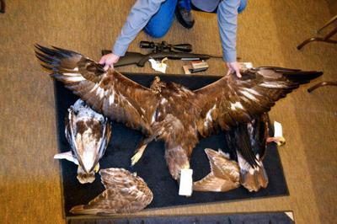
Enforcement
“Nine men from South Dakota, five women from South Dakota, one man from North Dakota, one man from Iowa, one man from Idaho, and two pawn shops in South Dakota were convicted of various Lacey Act, Migratory Bird Treaty Act, and Bald and Golden Eagle Protection Act violations.”
Lacey Act
  From $250 for marking violations to 5 years/$250,000
Migratory Bird Treaty Act
  First offense: max. 1 year/$5,000
  Organization felony: max. $500,000
Bald and Golden Eagle Protection Act
  First offense: max. 1 year/$100,000
  Second offense: felony, max 2 years/$250,000
https://rapidcityjournal.com/news/local/people-and-two-pawn-shops-sentenced-for-eagle-trafficking/article_c7159b56-cfcd-53c9-a7b3-ec521c3f4745.html
Notes:
Authorities can purse civil or criminal charges
Violators can be charges under several federal laws
Penalties increase for multiple instances and/or crimes committed by organizations
In September 2005, a Florida land development company responsible for the destruction of an eagle nest tree on property where it was building a housing development in Collier County, Florida, pleaded guilty to violating Bald and Golden Eagle Protection Act and was fined $356,125 – one of the largest penalties ever assessed under this statute. An individual associated with the company also pleaded guilty to violating the BGEPA and was sentenced in April 2006 to a $5,000 fine and three years on probation
In January 2005, two defendants who cut down a tree containing a bald eagle nest in Florida, pleaded guilty to violating the Act. One defendant was ordered to pay a $10,000 fine and contribute $80,000 in restitution ($40,000 to the Audubon Center for Birds of Prey and $40,000 to the National Fish and Wildlife Foundation’s Florida Bald Eagle Conservation Fund). The other was fined $10,000 and ordered to forfeit the chainsaw used to commit the crime.
Office of Law Enforcement for the U.S. Fish and Wildlife Service investigated SD case

Slide 11

Permits
Notes:
Numerous permits are available. Bald Eagles primarily under Bald Eagle Act, other migratory birds under Migratory Bird Treaty Act

Slide 12
Disturbing Activities
Category | Description | Minimum separation between activity and nest
 |  | Outside breeding season | Inside breeding season
A+B | Vertical and horizontal construction Agriculture and aquaculture Waterfront construction Mining Water impoundment | 330 ft – 660 ft Depending on construction footprint | 660 ft
C | Timber Operations and Forestry Practices | 330 ft | 660 ft
D | Off-Road Vehicle Use | 0 ft | 330 ft , 660 ft if visible
E | Motorized Watercraft Use | 0 ft | 330 ft, more if noisy
F | Non-motorized recreation (e.g., hiking) | 0 ft | 330 ft if visible/noisy
G | Aircraft (fixed and rotary wing) | ? | 1,000 ft
H | Blasting, Fireworks, other loud noises | ½ mile | ½ mile
Notes:
Eagles are unlikely to be disturbed by routine use of roads, homes, and other facilities where such use pre-dates the eagles’ successful nesting activity in a given area.
Eagle “take” is defined as: “pursue, shoot, shoot at, poison, wound, kill, capture, trap, collect, molest or disturb.”
Most takes are easy to understand, but a permit in our line of work will likely revolve around “Disturb’’ means: "Disturb means to agitate or bother a bald or golden eagle to a degree that causes, or is likely to cause, based on the best scientific information available, 1) injury to an eagle, 2) a decrease in its productivity, by substantially interfering with normal breeding, feeding, or sheltering behavior, or 3) nest abandonment, by substantially interfering with normal breeding, feeding, or sheltering behavior."
Eagle are extremely sensitive during the breeding season: March 1st through August 31st (other Migratory Birds are May 1st through July 15^{th)}
regional FWS offices administer permits for qualified applicants involving bald and golden eagles

Slide 13
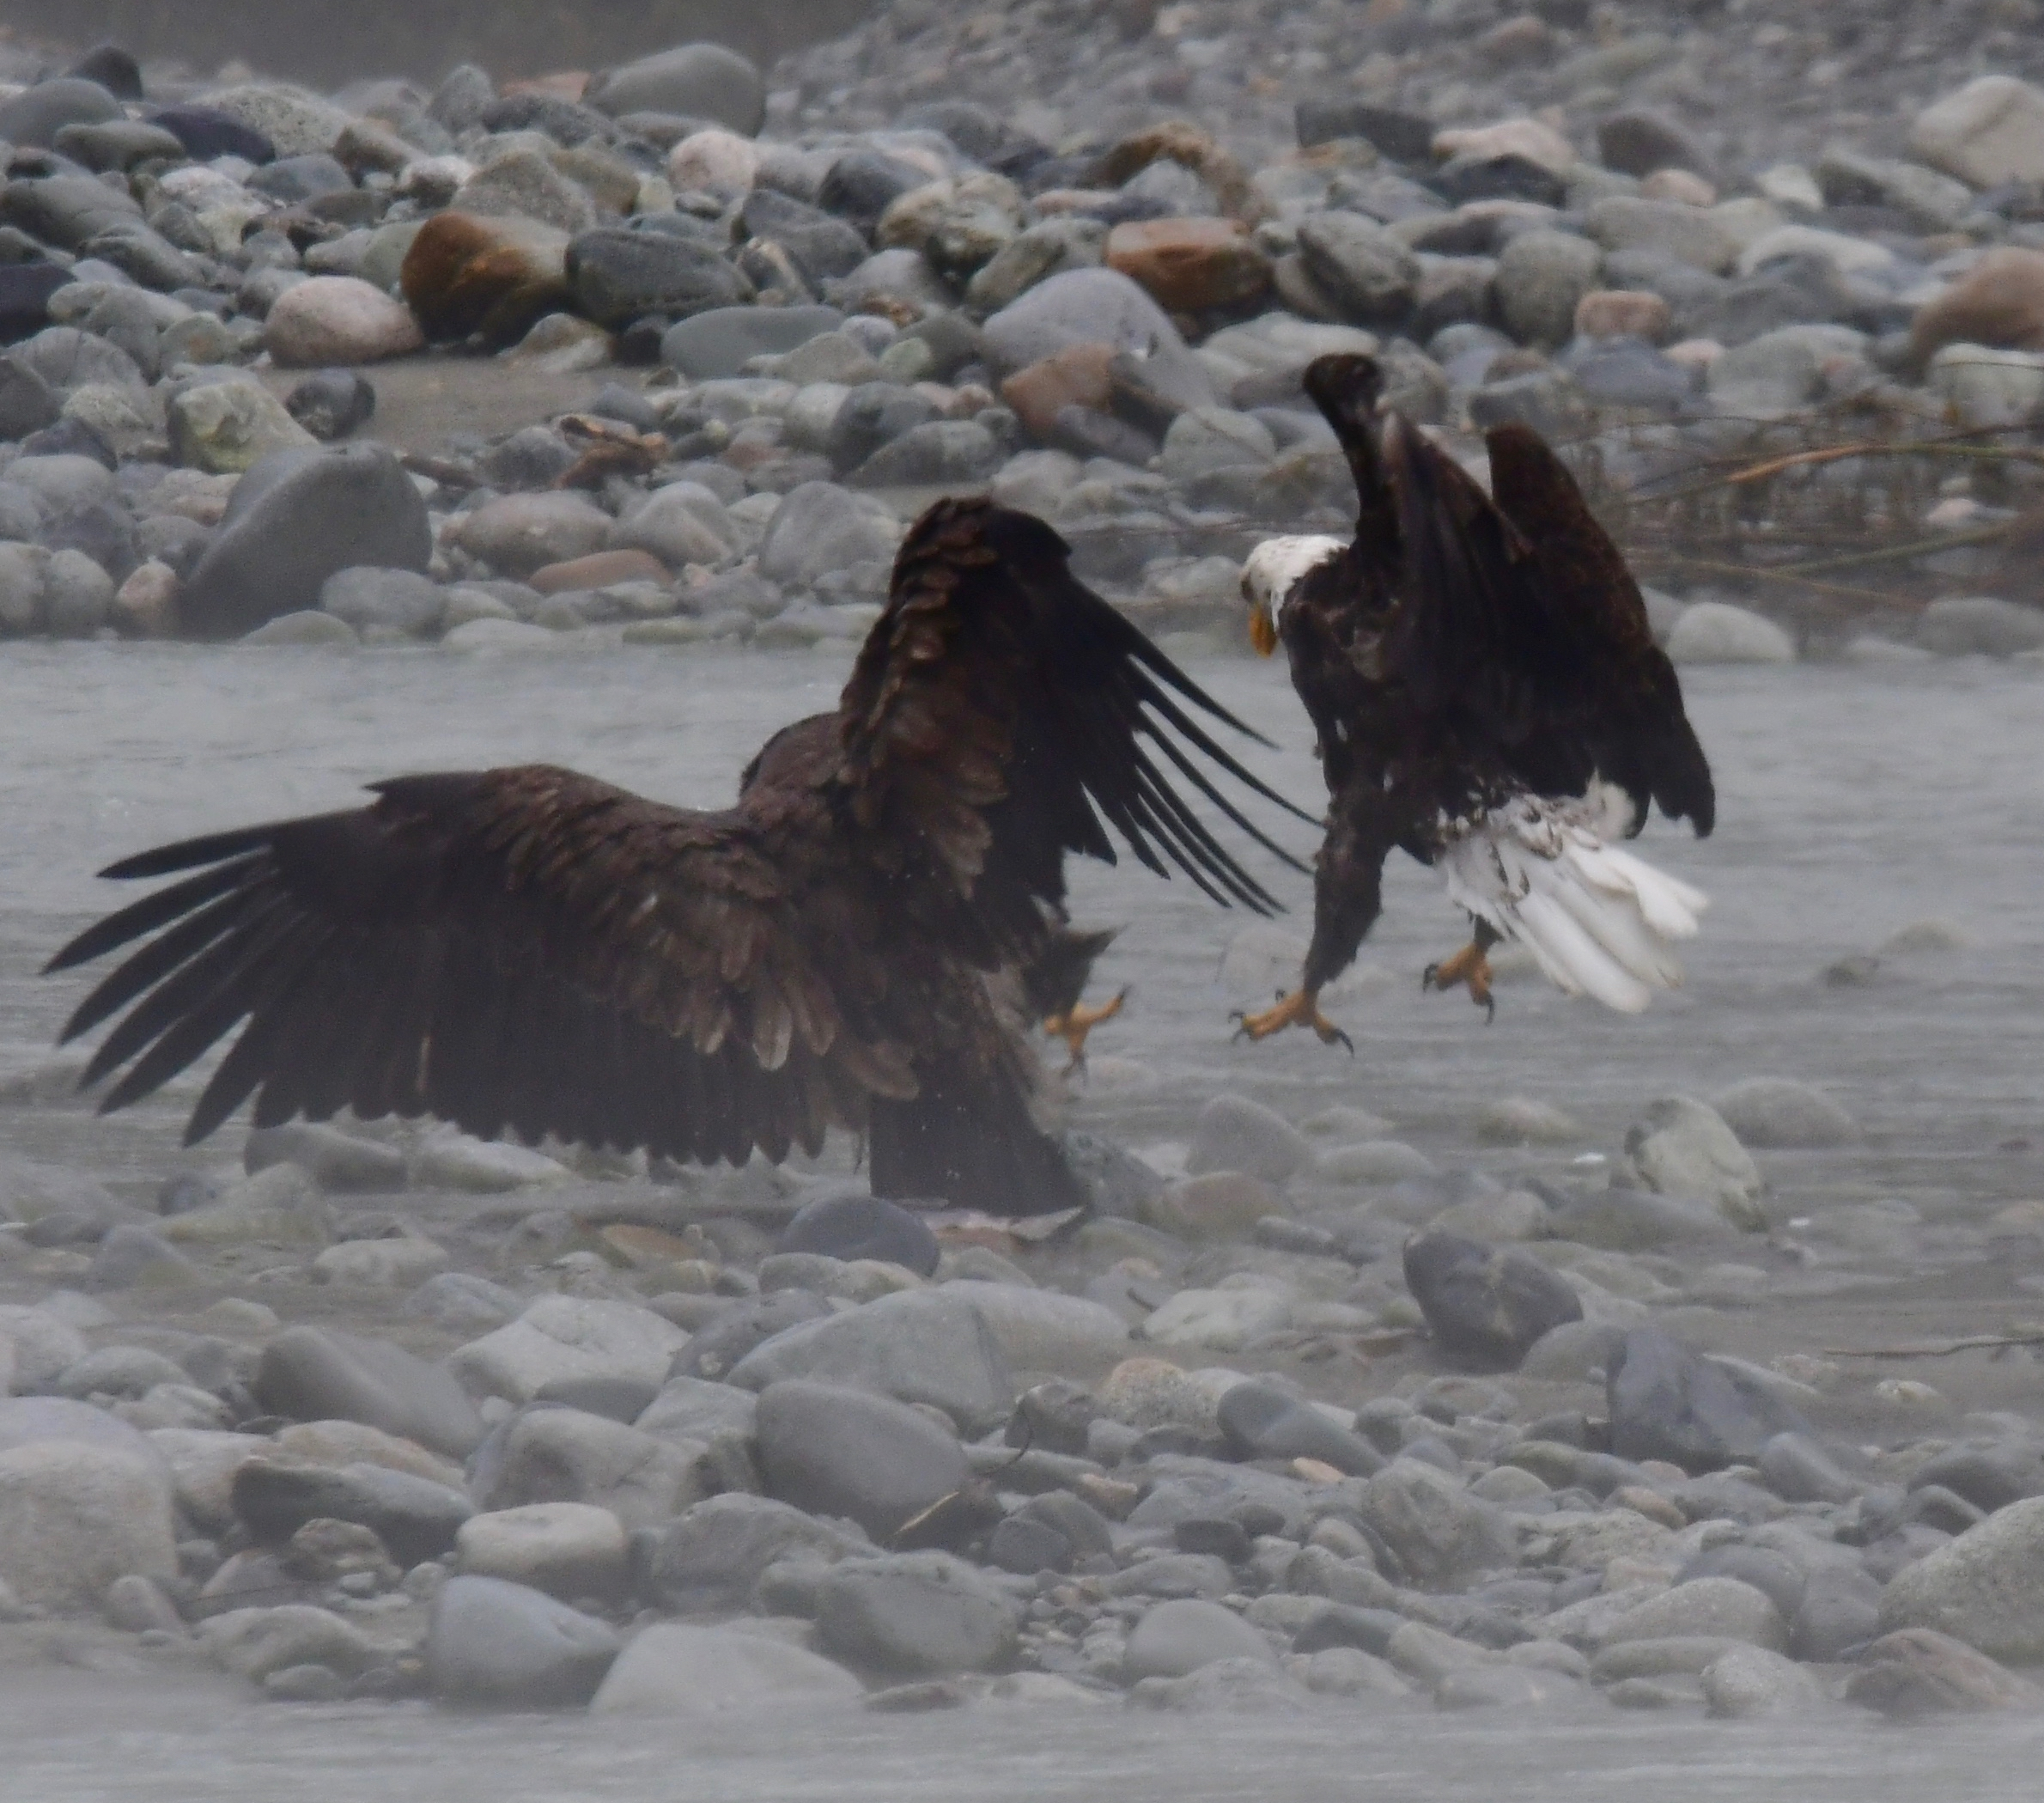
Types of Permits
Number | Permit Name
3-200-15a | Eagle Parts for Native American Religious Purposes
3-200-14 | Eagle Exhibition
3-200-16 | Eagle Depredation
3-200-17 | Eagle Falconry (Golden Eagles only)
3-200-70 | Int’l Transport for Native American Religious Purposes
3-200-69 | Int’l Transport for Scientific or Exhibition Purposes
3-200-18 | Take of Golden Eagle Nests
3-200-71 | Eagle Take (Necessary to Protect Interests in a Particular Locality)
3-200-72 | Eagle Nest Take
Notes:
Certain activities aren’t able to maintain the separations.
In 2009, after the species was delisted, USFWS promulgated a law published a rule under the Bald Eagle Protection Act authorizing a permit program that allows take of eagles under certain circumstances. (EA and FONSI)
50 CFR 22.26 governs the issuance of permits to take bald eagles and golden eagles where the take is associated with, but not the purpose of, the activity and cannot practicably be avoided
50 CFR 22.27 has established authority to issue permits for removing eagle nests where:
necessary to alleviate a safety emergency to people or eagles
necessary to ensure public health and safety
the nest prevents the use of a human-engineered structure or
the activity or mitigation for the activity will provide a net benefit to eagles
Eagle Parts request to request eagles, parts and feathers for Native American religious purposes from the National Eagle Repository
Located in Denver, Colorado, central location for storage and distribution of eagle parts to Native Americans/Alaskans
Eagle Exhibition Permit authorizes the recipient to possess and transport eagles for the sole purpose of educating the public about the biology, ecology, and conservation needs of eagles.
Eagle Depredation Permit is required to take or disturb bald or golden eagles that have become injurious to wildlife, agriculture or other personal property, or human health or safety.
An International Transport for Native American Religious Purposes Permit is required for the export, reimport, or transport of bald or golden eagle parts from or to the United States for Native American religious purposes.
An International Transport for Scientific or Exhibition Purposes Permit is required for the export, reimport, or transport of bald or golden eagle parts from or to the United States for scientific or educational exhibition purposes.
An Eagle Take (Necessary to Protect Interests in a Particular Locality) permit authorizes take of live bald and golden eagles and their eggs, where the take is associated with, but not the purpose of some human activity or project, and where take cannot practicably be avoided.
An Eagle Nest Take Permit authorizes removal or relocation of an eagle nest in certain instances, including an active or inactive nest where necessary to alleviate a safety emergency; an inactive nest when the removal is necessary to ensure public health and safety; an inactive nest that is built on a human-engineered structure and creates a functional hazard that renders the structure inoperable; or an inactive nest in certain other instances where the take or the mitigation for the take will provide a clear and substantial benefit to eagles.

Slide 14
Application Process

Slide 15
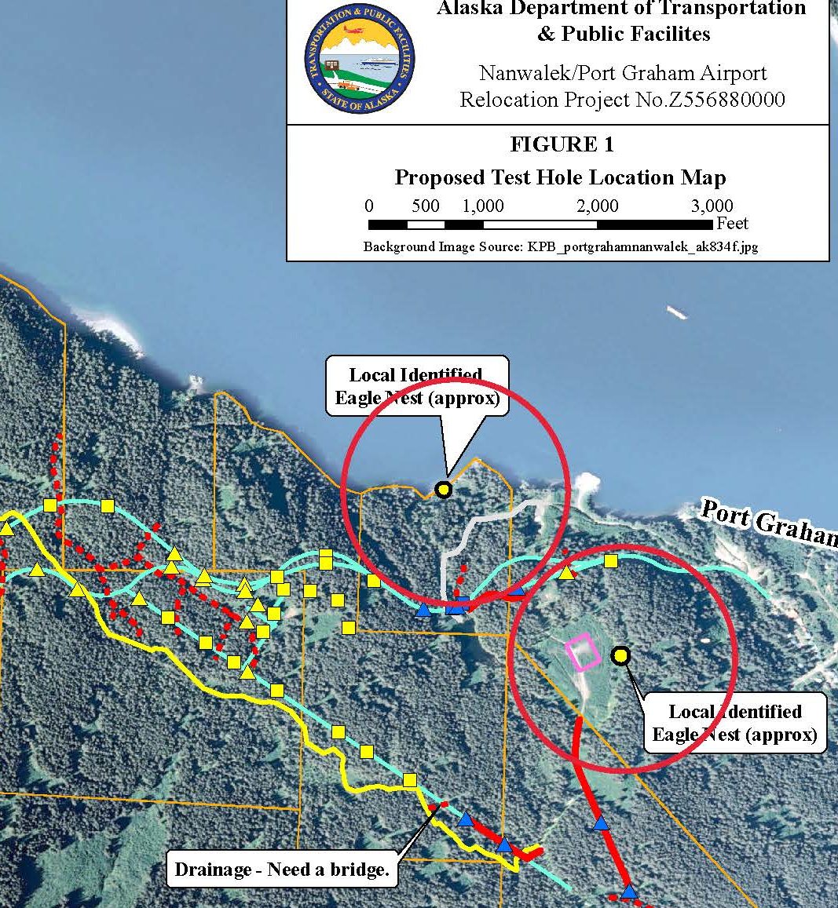
Nest Identification
Anecdotal Information
Ground survey
Aerial Survey
  Excluded from permit
Notes:
No prescriptive requirements for eagle survey, but some experience preferred

Slide 16
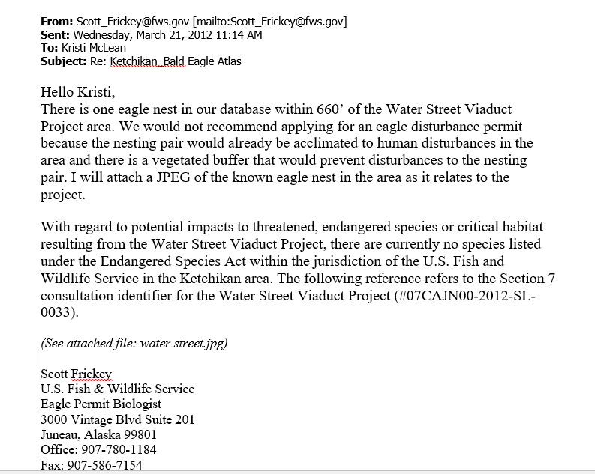
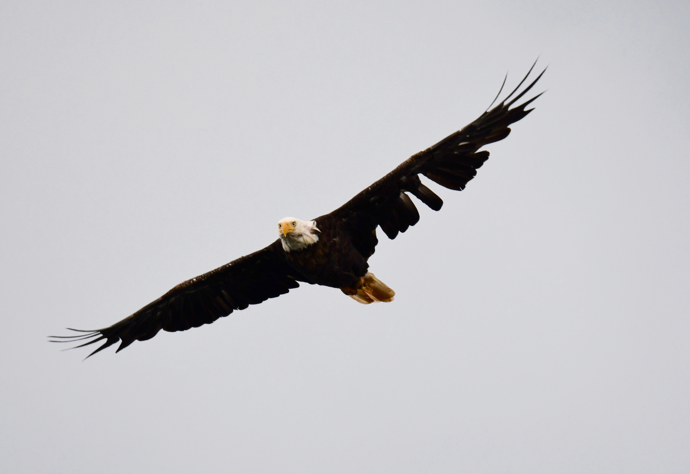
Consultation
Notes:
Consultation with agencies, as we’ve heard time and time again, can save a lot of headaches later.
The Service will initially cap permitted bald eagle take at a five percent of their estimated annual regional productivity within each Service region. This approach is consistent with peer-reviewed recommendations used by the Service to manage other raptors. The Service does not expect that demand for the new permits for bald eagles will approach these thresholds in most areas of the United States.

Slide 17
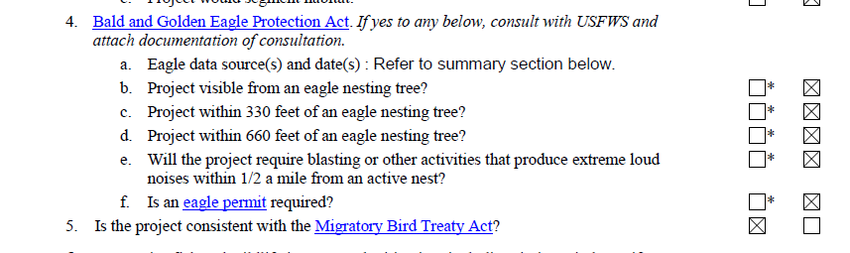
NEPA Document

Slide 18
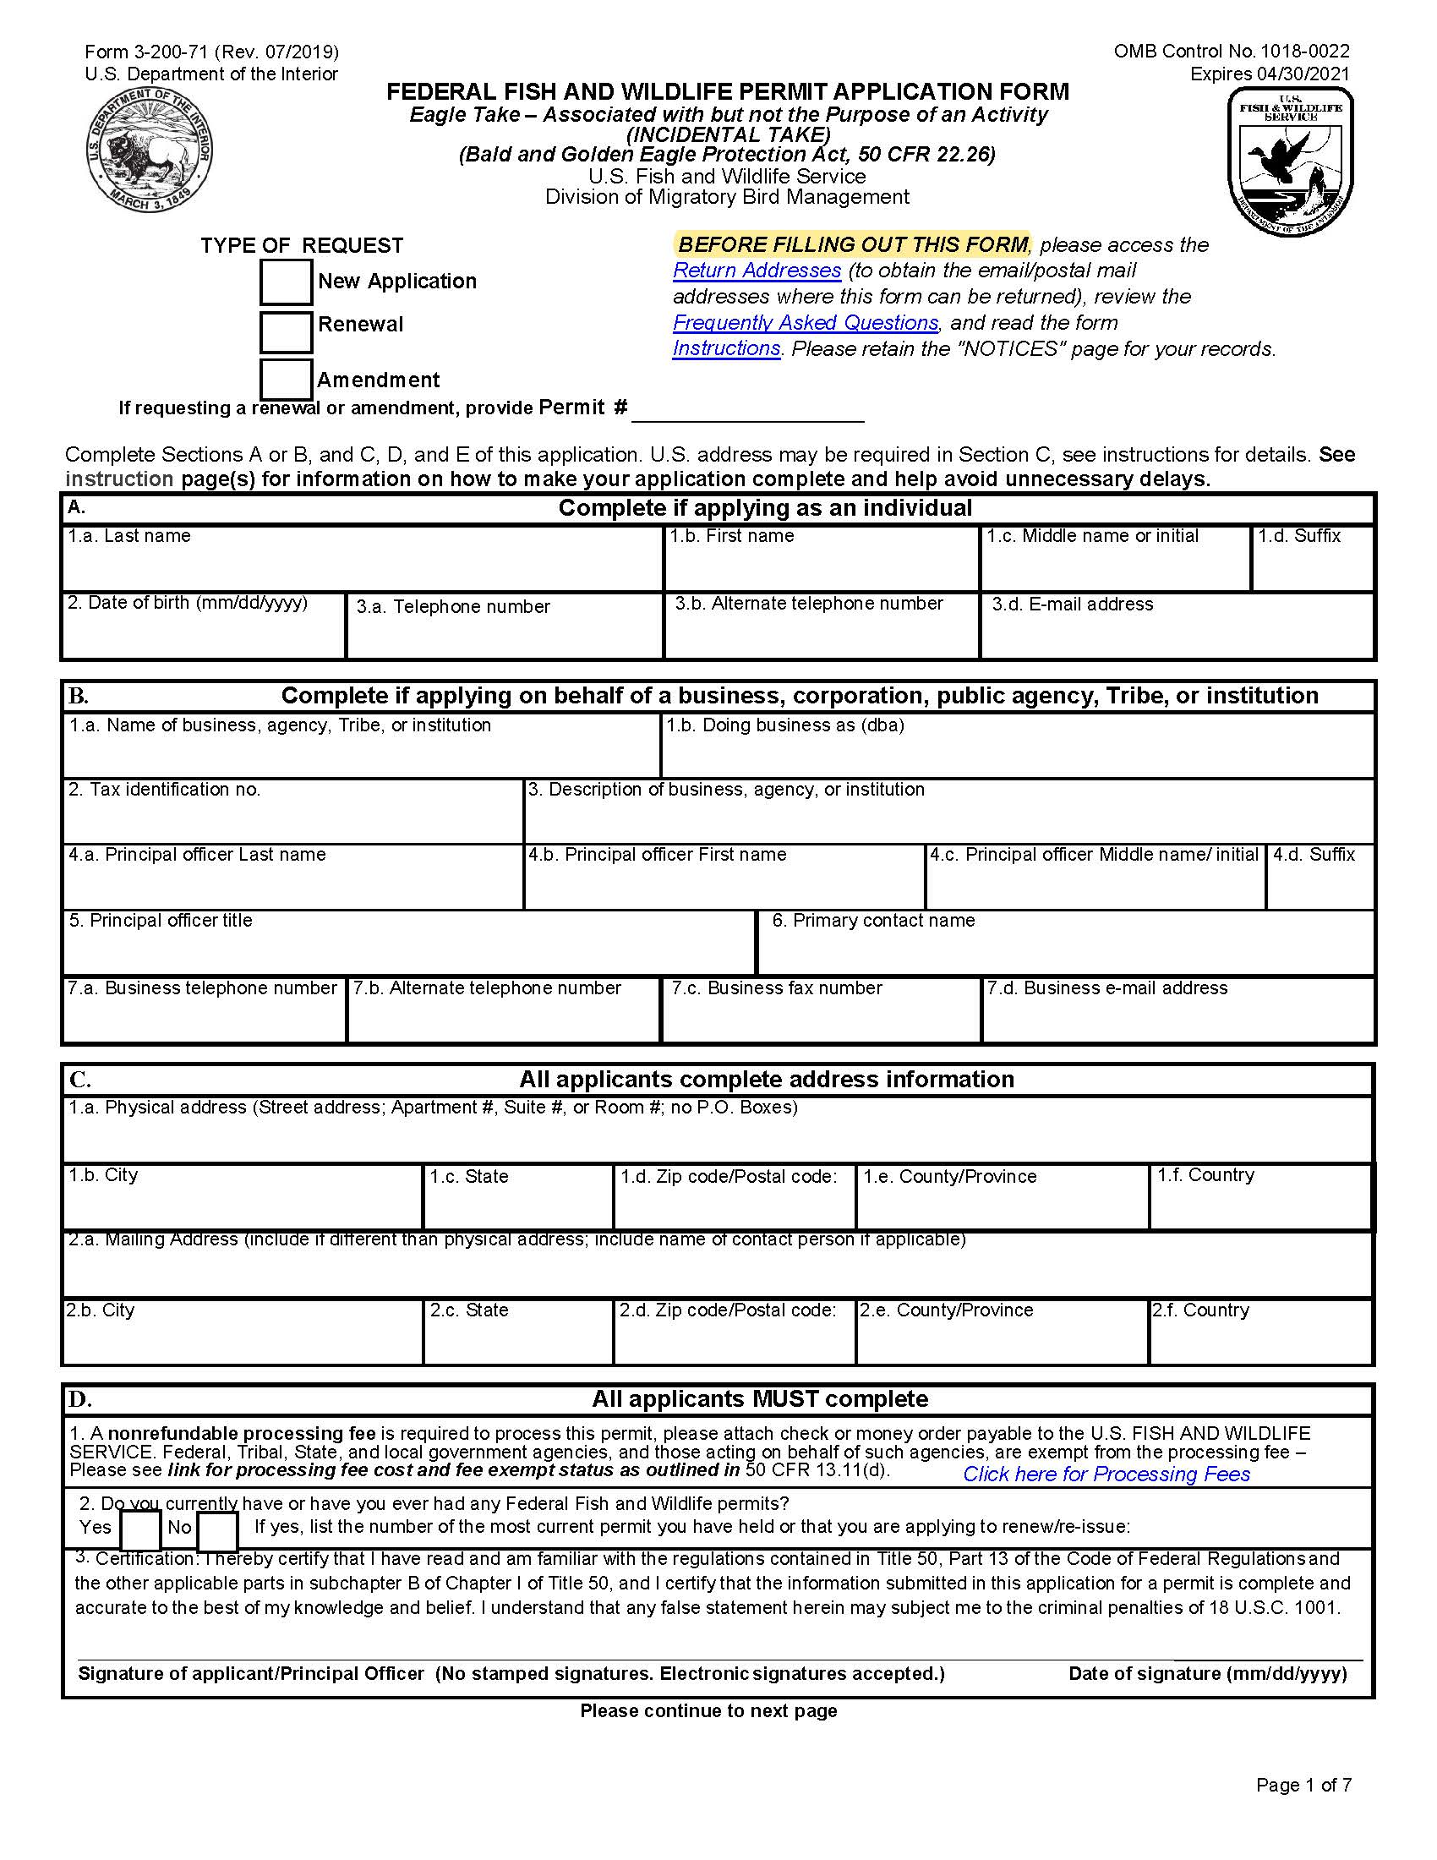
Application
Contact info
Certification
Magnitude and Type of Take
Duration
Project Description
Define Need
Eagle Activity
Disturbance
Avoidance, Minimization, Mitigation, and Monitoring
Other
Notes:
The Service will initially cap permitted bald eagle take at a five percent of their estimated annual regional productivity within each Service region. This approach is consistent with peer-reviewed recommendations used by the Service to manage other raptors. The Service does not expect that demand for the new permits for bald eagles will approach these thresholds in most areas of the United States.

Slide 19
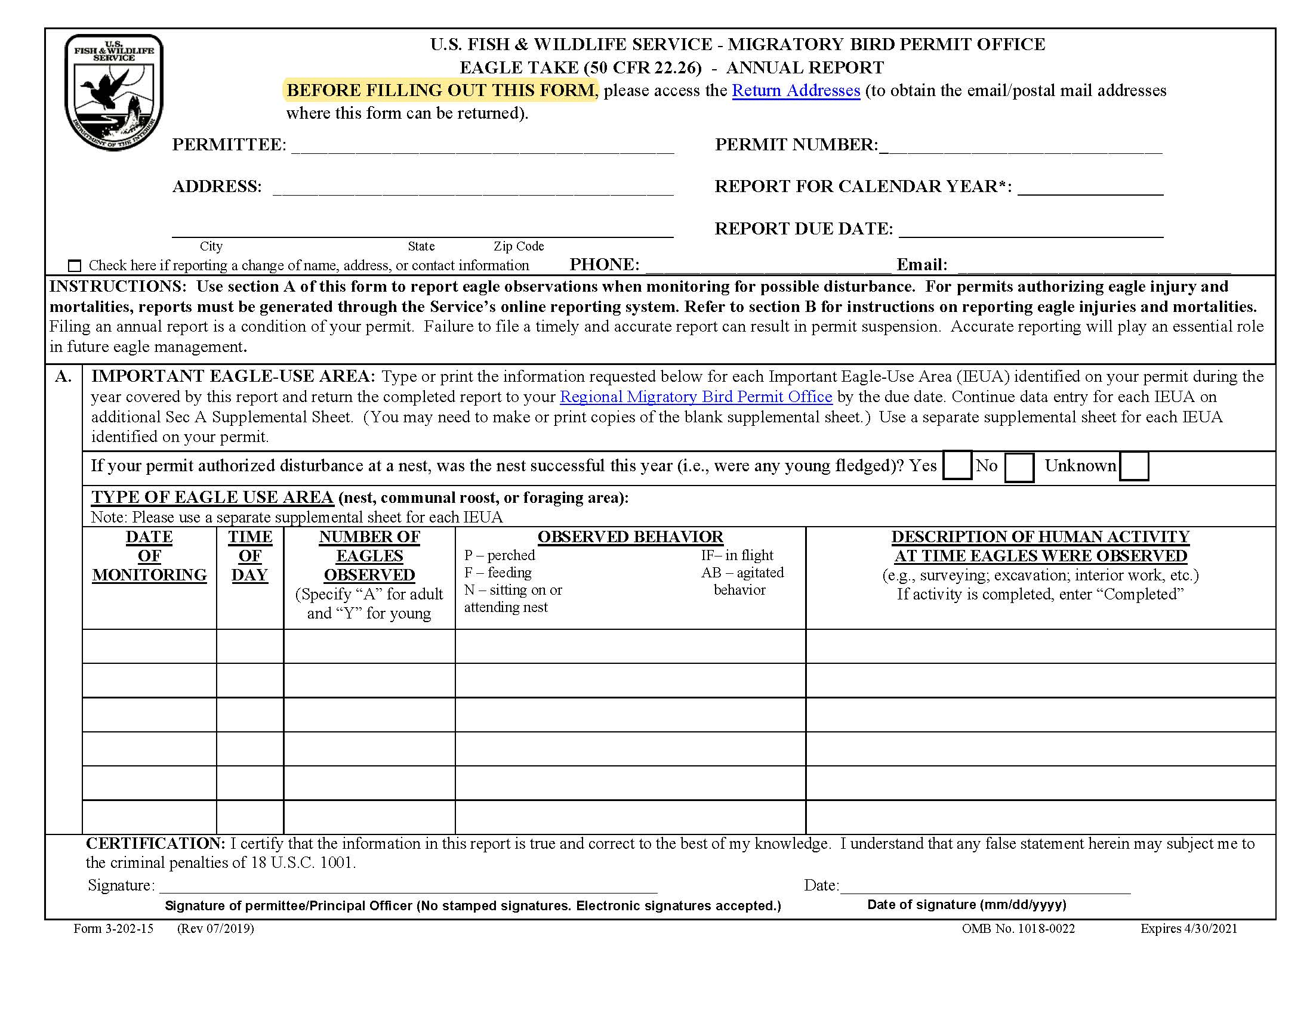
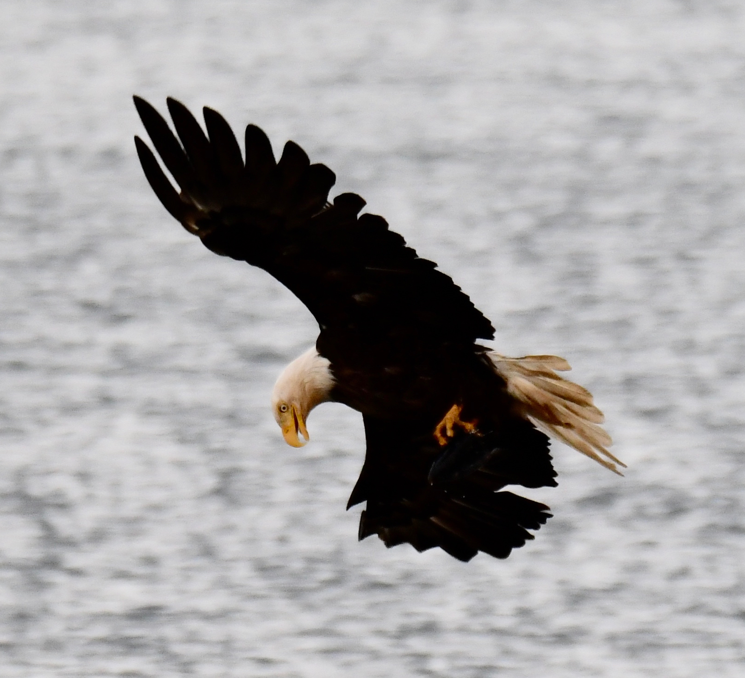
Monitoring
Permit may require monitoring to reduce the likelihood for eagle takes

Slide 20
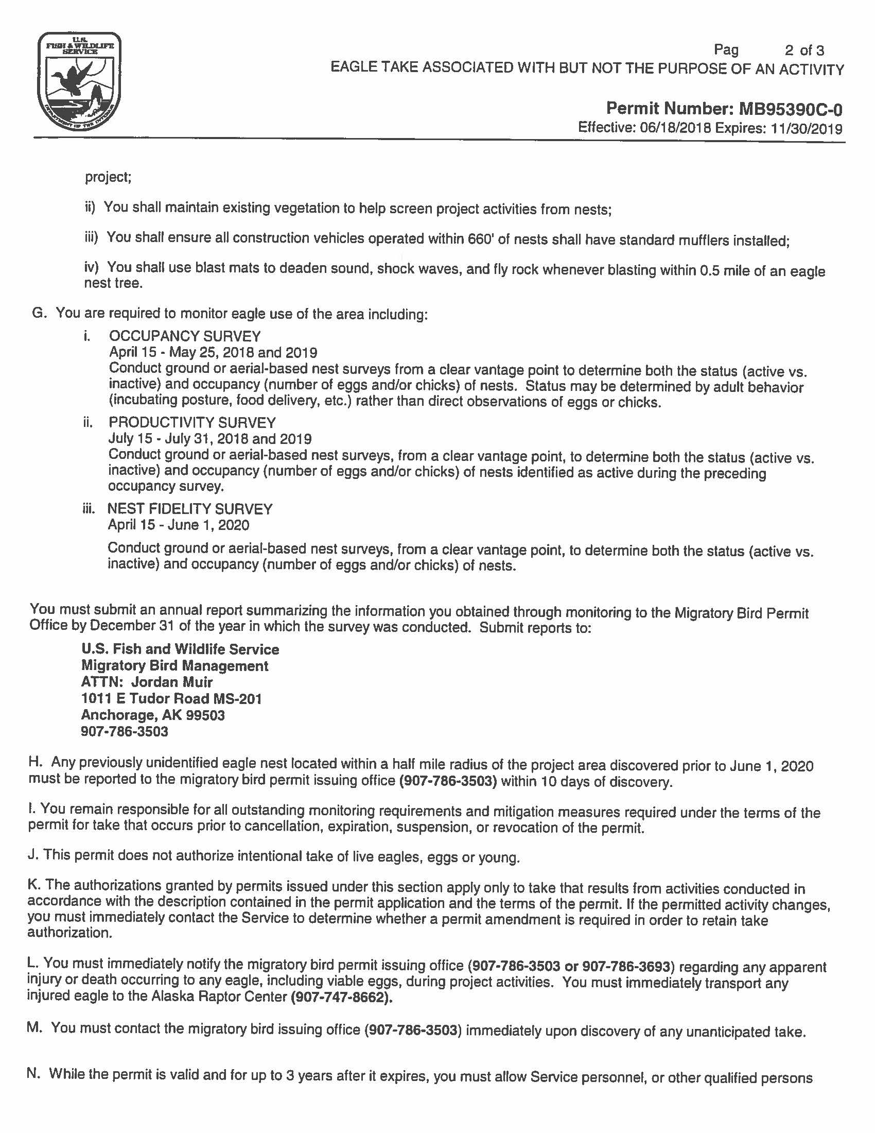
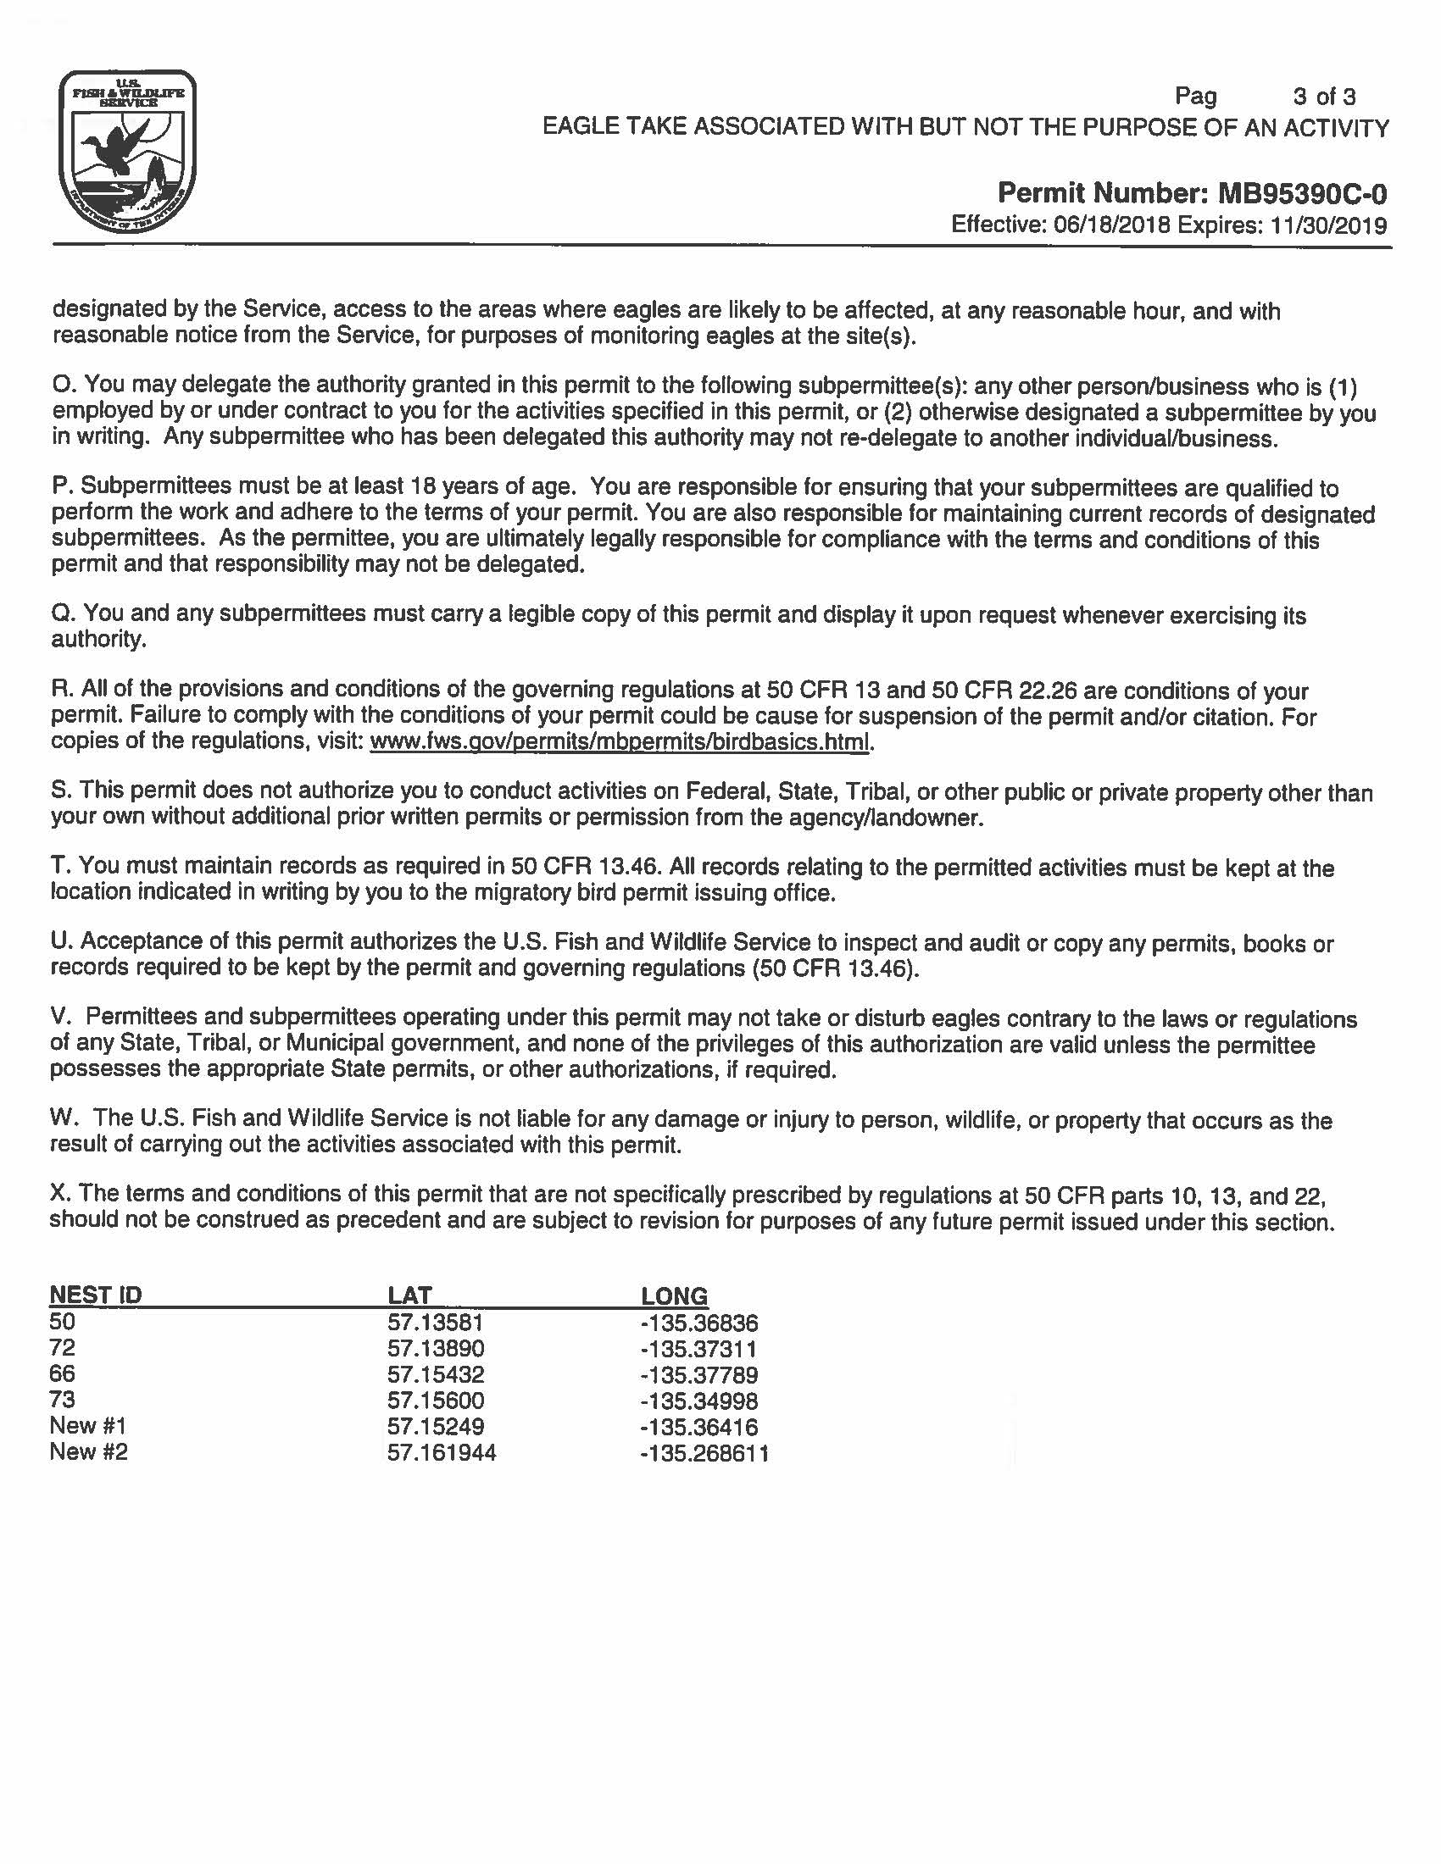
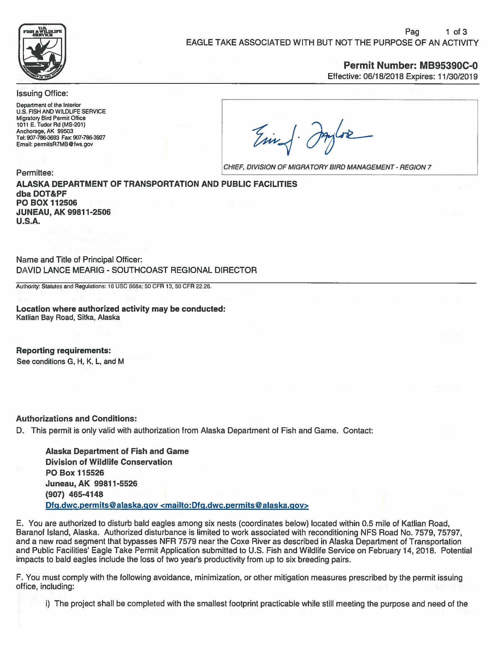
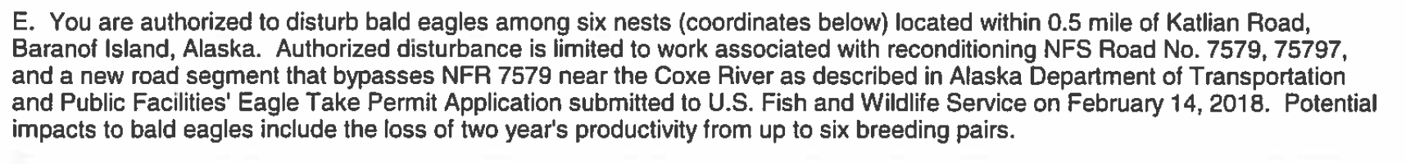
Permit
Notes:
What is authorized
Avoidance and mitigation statement
Monitoring and reporting requirements
Notification requirements if new nests are discovered or injury/death of eagles
Validity of permit

Slide 21
Fees and Processing
2-24 months
Eagle Take & Eagle Nest Take Standard Permit | $500
Eagle Take & Eagle Nest Take Standard Permit Amendment | $150
Eagle Take & Eagle Nest Take Programmatic | $1000
Eagle Take & Eagle Nest Take Programmatic Amendment | $500
Notes:
Previous permit example was issued within four months of application
It was issued five months before the project went to bid

Slide 22
Contact Info
Jordan Muir
Supervisory Wildlife Biologist - Raptors/Permit
REGION 7
Alaska
U.S. Fish and Wildlife Service
Migratory Bird Permit Office
1011 E. Tudor Road
Anchorage, AK 99503
Tel. (907) 786-3693
Fax (907) 786-3641
Email: permitsR7MB@fws.gov
Notes:
Jordan’s name: coincident? John Muir, father of the National Park system

Slide 23
References
https://en.wikipedia.org/wiki/Bald_and_Golden_Eagle_Protection_Act
https://www.fws.gov/birds/management/managed-species/bald-and-golden-eagle-information.php
https://www.fws.gov/pacific/eagle/documents/NationalBaldEagleManagementGuidelines.pdf
https://www.fws.gov/alaska/pages/eagle-permit-types
Eagle Photographs by Sascha Brand

Slide 24
THANK YOU!
Marc Frutiger, PE, PTOE
Email
mfrutiger@alaska.edu

